Slide 1

INFO-I 590 Data Visualization
Blended Visual Beats:
Visualizing Playlist Comparisons and Personalized Music Recommendations
Group 7 Members
Swarn Gaba | Rutuja Jangle | Gandhar Ravindra Pansare
INDIANA UNIVERSITY BLOOMINGTON

Slide 2

INTRODUCTION
Music holds the power to evoke emotions, connect people, and shape cultures, making its understanding and analysis crucial for appreciating its profound impact on human lives and society.
Music analysis enables us to dissect compositions, uncover patterns, and personalize musical experiences, enriching our appreciation of this universal art form.
Spotify is the world’s most popular audio streaming subscription service^{[1]} with over 574 million users (226 million subscribers) across more than 180 countries. It is a rich source for data, and this data can be leveraged to do various analyses.

Slide 3
ABSTRACT
This project aims to analyze and compare Spotify playlists using visualizations to explore similarities and differences in music attributes such as genre, artist, and energy. By identifying the common trends and data-driven insights, it will generate personalized music recommendations for playlist listeners. Through simple and intuitive visualizations, both static and dynamic approaches will be explored to create an interactive dashboard that enables users to compare playlists, gain insights into their music tastes, and receive tailored recommendations based on shared or similar interests.
Key Goals:
Visualize and compare musical traits between two playlists.
Generate recommendations based on common trends.
Make data analysis user-friendly with interactive visualizations.

Slide 4


PROJECT OBJECTIVES
Key Questions:
How similar or different are the two playlists in terms of musical features (e.g., energy, danceability, genres)?
How can we visually capture these differences?
What common traits can we derive from comparing multiple musical attributes?
How can we generate personalized recommendations based on shared musical traits?

Slide 5
MOTIVATION
Fueling Curiosity and Music Discovery: This project offers a unique way to explore personal music tastes, uncover hidden connections between artists and genres, compare preferences, and enhance music discovery through engaging visualizations. It provides exciting insights for both users and researchers.
Why is this project important? Why Should We Care?
Music is highly personalized, and Spotify’s Blend feature allows users to share playlists, but it lacks detailed visual comparisons. Our project fills this gap by adding a visual element to the comparative analysis.
Quantifying Motivation and Inspiration: With over 574 million users across more than 180 countries, Spotify provides a vast and diverse dataset ideal for meaningful analyses. The project draws inspiration from Spotify’s Blend feature, aiming to enhance the music recommendation experience by leveraging this rich data to visualize user preferences, patterns, and diverse musical attributes. By adding detailed visual comparisons, our project has the potential to impact a large user base, offering new ways to discover music and personalize listening experiences on a global scale.

Slide 6
EXISTING VISUALIZATIONS AND CRITIQUES
Stats for Spotify^{[6]}: A simple tool to view top genres, artists, and tracks. However, it provides little insight into relationships between playlists or trends.
Critique: Visuals lack depth; the platform only shows bar charts without comparison features.
Spotify Pie^{[7]}: Visualizes genres in a pie chart format.
Critique: The pie chart does not add up to 100% and is confusing; lacks interactivity and comparison options.
Obscurify^{[8]}: Focuses on the obscurity of users’ music taste relative to popular trends.
Critique: Useful but text-heavy; lacks visual insights and comparisons across multiple playlists.
Musictaste.space^{[9]}: Offers playlist comparisons and some shared recommendations.
Critique: Lacks detailed visualizations, especially for exploring new trends or deeper insights.
Current tools provide basic insights but lack interactive visual comparisons and comprehensive recommendations. Our project focuses on creating meaningful, easy-to-understand visualizations that enhance user experience by using visual traits to drive deeper insights and personalized recommendations.

Slide 7
DATASET OVERVIEW
Data Source: Spotify API provides access to detailed song and artist information.
Data Collection: Using API calls, we have extracted different playlists, artists, track details, and song attributes like tempo, energy, danceability, and genre.
Data is tabular with mixed column data types.
Data Cleaning and Processing: We have cleaned the data to ensure consistency and completeness. Missing values had been handled, and data had been transformed for easy analysis.
Why is the Dataset Adequate?
Comprehensive Features: The dataset provides key musical attributes (e.g., energy, popularity), ideal for comparing playlists visually.
Diverse Data: Includes a wide range of genres and artists, enabling cross-genre and cross-artist analysis.
Track Popularity: By incorporating popularity scores, the dataset allows personalized recommendations based on user preferences and trends.
Structured for Visualizations: Rich and well-organized data supports insightful visualizations of playlist similarities, differences, and recommendations.

Slide 8
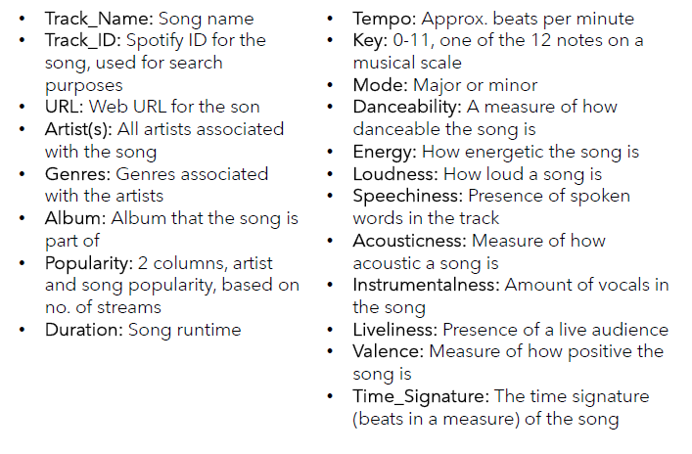
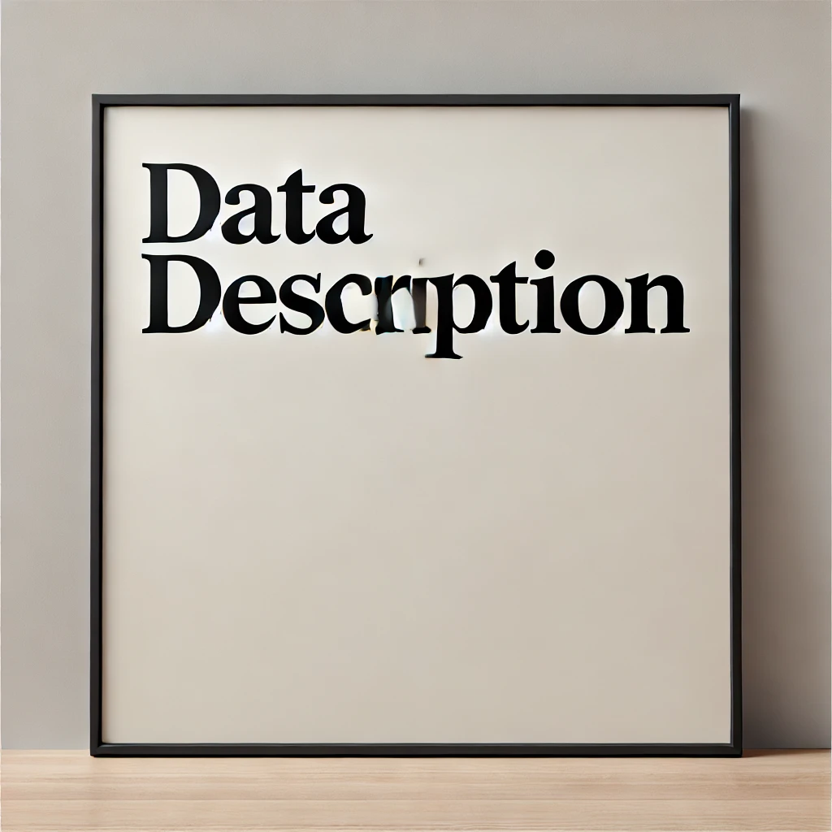

Slide 9
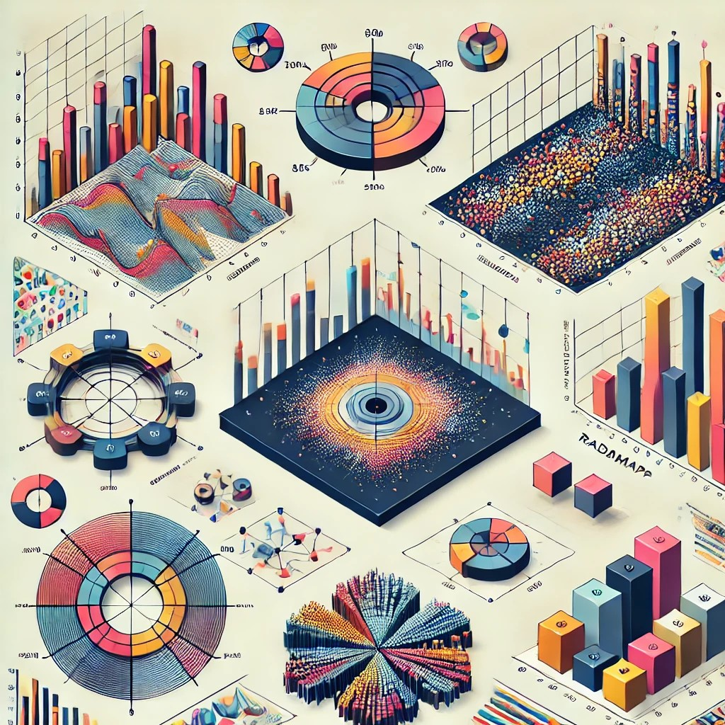
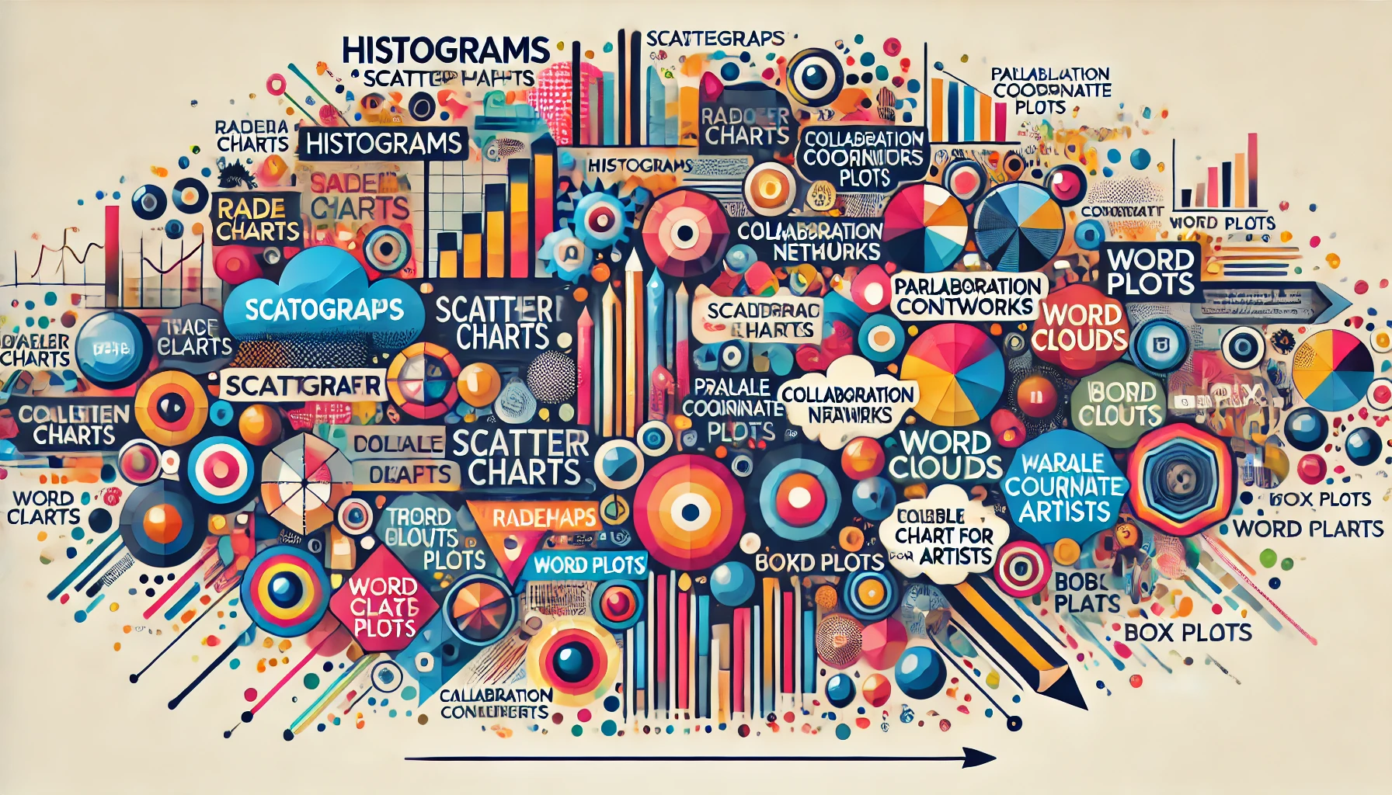
PROPOSED VISUALIZATIONS AND METHODS

Slide 10
Histograms/CDFs: Compare features like tempo, energy, and popularity between two playlists.
Scatterplots: Analyze relationships between multiple variables, such as energy, danceability, and popularity.
Radar Charts: Compare the aggregated values of multiple musical attributes like danceability and valence.
Treemaps: Visualize the distribution of genres and artists across playlists.
Collaboration Networks: Display artist collaborations, showing connections and hidden links between different artists across the two playlists.
Parallel Coordinate Plots: Compare song features (Danceability, Energy, Loudness, etc.) across popularity levels for both playlists, visualizing multivariate relationships.
Word Clouds: Display common music genres in Playlist 1 and Playlist 2, with word size representing genre frequency.
Box Plots: Show the distribution of song durations across genres, highlighting variations and outliers.
Bubble Chart: Visualize all artists from both playlists, with bubble size indicating the number of songs and color distinguishing the playlist.

Slide 11
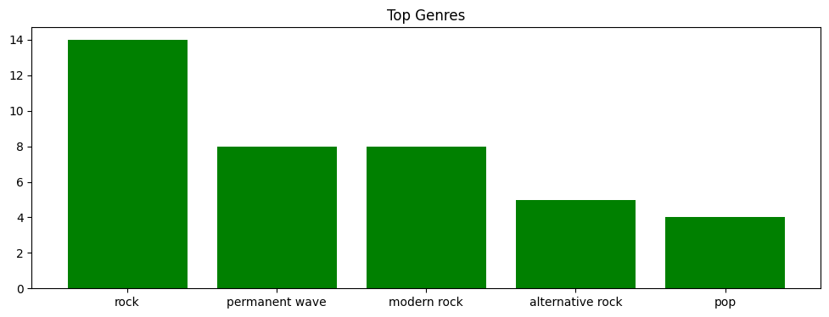
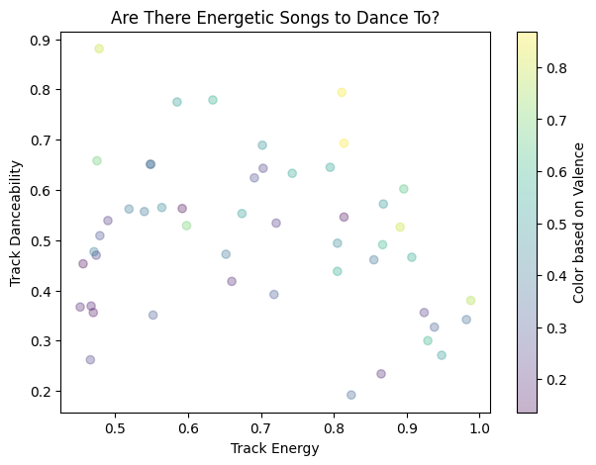
SAMPLE VISUALIZATIONS
Individual Playlist Data: These visualizations show key insights from the playlist data, including the top genres and the relationship between track energy, danceability, and valence, helping to identify trends and similarities within each playlist.

Slide 12
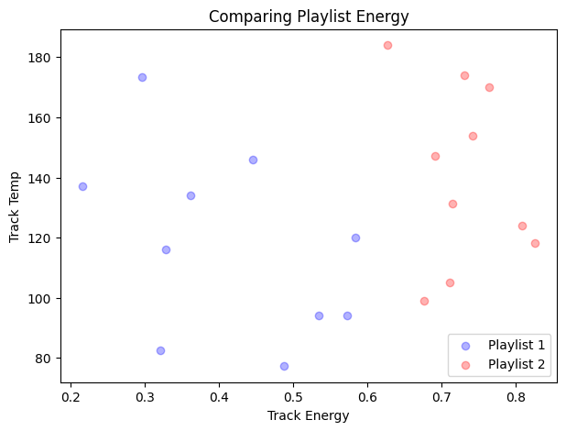
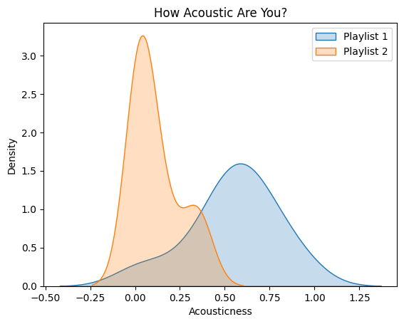
Comparing Playlist Data: These visualizations compare two playlists based on various musical attributes such as energy, tempo, and acousticness, highlighting how the playlists differ or overlap, and offering insights into how track characteristics vary between the two.
Notes:
To further explore the data, we plotted Average amount spent on different products first based on age and then customer’s marital status.The plots are colored by products.
The first bar chart reveals wine as the predominant spending category across all ages, peaking with the 66-75 group, followed by meat. Other categories like fish, fruits, and sweets are less favored, while gold maintains a steady, modest appeal. Moreover customers in the oldest age group tend to spend the most among all age groups.
The bar chart highlights spending by relationship status, showing widows as top spenders across all categories, with a strong preference for wines. Across the board, wines dominate expenditures, followed by meat, reflecting similar spending patterns among all relationship statuses.

Slide 13
REFERENCES
[1] “Spotify—About Spotify,” Spotify, Oct. 24, 2023. https://newsroom.spotify.com/company-info/
[2] “How to visualize Spotify music trends in Tableau.” https://www.tableau.com/blog/how-visualize-spotify-music-trends-tableau
[3] “Visualizing Spotify Data with Python and Tableau.” https://towardsdatascience.com/visualizing-spotify-data-with-python-tableau-687f2f528cdd
[4] “Spotify Song Attributes Analysis.” https://www.kaggle.com/code/krishnabhatt4/spotify-song-attributes-analysis
[5] “A simple guide to visualizing your Spotify listening data… badass-ly. ” https://thenextweb.com/news/a-simple-guide-to-visualising-your-spotify-listening-data-badass-ly
[6] “Stats for Spotify.” https://www.statsforspotify.com/
[7] “My Spotify Pie - Top artists - Top genres.” https://huangdarren1106.github.io/spotify-pie
[8] “Obscurify Music.” https://www.obscurifymusic.com/home
[9] “Compare your Spotify music taste! - Musictaste.space.” https://musictaste.space/
[10] “Exploring Music Rankings with Interactive Visualization.” https://www.researchgate.net/profile/Leandro-Guedes-2/publication/317553482_Exploring_Music_Rankings_with_Interactive_Visualization/links/5a2b8b600f7e9b63e538e943/Exploring-Music-Rankings-with-Interactive-Visualization.pdf

Slide 14
Thank you

